Slide 1




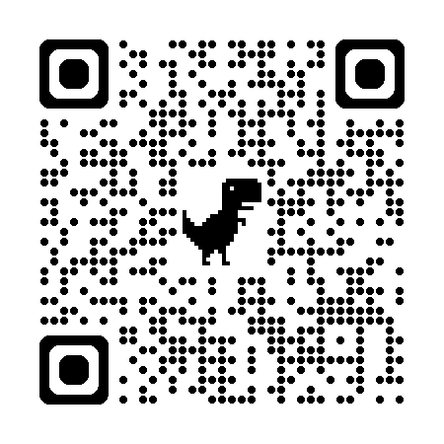

Speak
Out
Online Anonymous Reporting Tool
Speak Out is an online anonymous reporting tool for all HEI staff, students, and visitors to disclose any form of bullying, harassment, discrimination, or sexual violence they experience or witness. It provides links to support services within each HEI and in the wider community.
INSERT HEI QR CODE TO SPEAKOUT WEBSITE HERE
For more info
www. tus.speakout.ie

Slide 2

Speak
Out
1,011
You can also make a formal report of negative behaviours to your Higher Education Institution under the following policies:
Students:
TUS Student Policy on Dignity and Respect: Dealing with Harassment and/or Bullying among Students
TUS Student Code of Conduct and Discipline
TUS Policy & Procedure for Responding to Sexual Violence & Sexual Harassment
People from 16 Higher Education Institutions made reports to Speak Out between 1 Sept 2022 and 31 August 2024.
STAFF:
Thank you to all of those who spoke out.
Dignity and Respect at Work Policy and Procedure
TUS Policy & Procedure for Responding to Sexual Violence & Sexual Harassment
For more info
www. tus.speakout.ie

Slide 3





Speak
Report Data *
20%
Out
22%
Harassment
14%
Bullying
Discrimination
Between 1 Sept 2022 and 31 August 2024, bullying, harassment and discrimination were the most common forms of abuse reported to Speak Out by both students and staff across 16 Higher Education Institutions. You are not alone. You can report bullying, harassment and discrimination through
the:
TUS Student Policy on Dignity and Respect: Dealing with Harassment and/or Bullying among Students
Staff Dignity and Respect at Work Policy and Procedure
INSERT HEI QR CODE TO SPEAKOUT WEBSITE HERE

Slide 4

Speak
Out
202*
Between September 2022 and 31st August 2024, 202 students from 16 Higher Education Institutions reported some form of sexual violence anonymously to Speak Out. This included sexual assault, sexual harassment, and rape.
You can make a report through the TUS Policy & Procedure for Responding to Sexual Violence & Sexual Harassment by contacting svh@tus.ie
For support please visit www. tus.ie/esvh/support/
INSERT HEI QR CODE TO SPEAKOUT WEBSITE HERE
#YouAreNotAlone

Slide 5

Speak
Out
TUS EDI Office works to create an Equitable, Diverse, and Inclusive environment for all our community. Speak Out can guide you to support available within TUS and within the wider community if you have been subjected to any form of negative behaviour.
*Data from 16 HEIs during the period 1 September 2022 - 31 August 2024
56%
44%
of students and
of staff reporting to Speak Out described the abuse that happened as related to one of the
9 grounds of discrimination. *
For more info
www. tus.speakout.ie

Slide 6

Speak
Out
Most People reporting Speak Out who told someone else about the abuse that happened disclosed to a friend or family member.
What is a good response if someone discloses abuse to you?
Listen to the person
Believe what they are telling you
Acknowledge their feelings
Signpost them to a professional support service
Get support for yourself after a disclosure
INSERT HEI QR CODE TO SPEAKOUT WEBSITE HERE
#YouAreNotAlone

